Slide 2
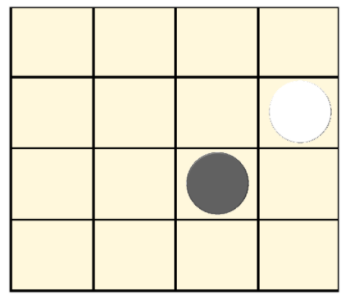
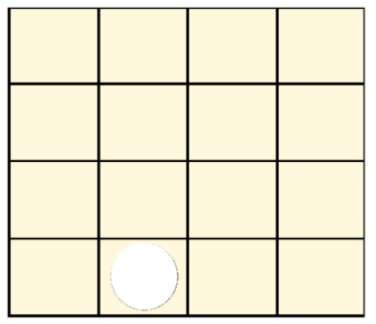
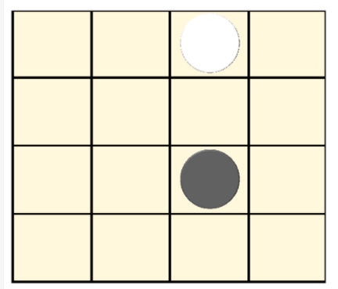

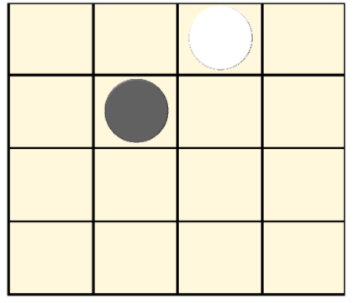
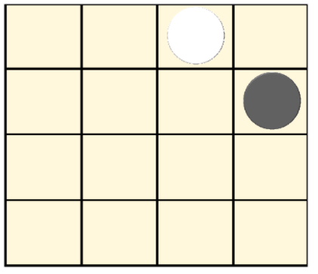




$$Valor α−β=1$$
$$max⁡\{−1,1,0\}$$
$$Valor α−β=0$$
$$main\{−1,1,0\}$$
$$Utilidad=1$$
$$Valor α−β=0$$
$$max⁡\{−1,1,0\}$$
$$Valor α−β=0$$
$$max⁡\{−1,1,0\}$$
.
.
.
.
.
.

Slide 3
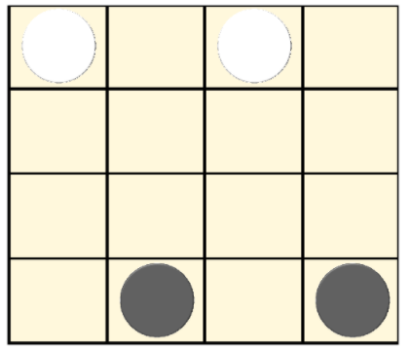










$$x$$
$$0$$
$$1$$
$$2$$
$$3$$
$$0$$
$$1$$
$$y$$
$$2$$
$$3$$

Slide 4
$$x$$
$$0$$
$$1$$
$$2$$
$$3$$
$$0$$
$$1$$
$$y$$
$$2$$
$$3$$

Slide 5
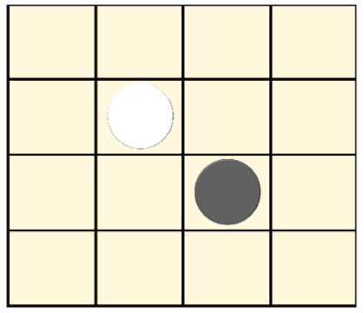
$$x$$
$$0$$
$$1$$
$$2$$
$$3$$
$$0$$
$$1$$
$$y$$
$$2$$
$$3$$

Slide 6
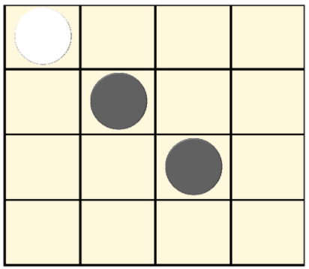
$$x$$
$$0$$
$$1$$
$$2$$
$$3$$
$$0$$
$$1$$
$$y$$
$$2$$
$$3$$

